Slide 1

#LifeKoKaroLift
Investment Pre-assignment
Live Session

Slide 2



Course : Machine Learning
Lecture On : Investment Pre-assignment
Instructor : Manish Kumar

Slide 3
Today’s Agenda
  Problem Statement walkthrough
  The objectives for the assignment
  Analysis Steps and Checkpoints
  Pre-Modelling Steps
  Q & A

Slide 4

Investment Case Study
What is Spark Funds?
You work for Spark Funds, an asset management company. Spark Funds wants to make investments in a few companies. The CEO of Spark Funds wants to understand the global trends in investments so that she can take the investment decisions effectively.
Business objective: The objective is to identify the best sectors, countries, and a suitable investment type for making investments. The overall strategy is to invest where others are investing, implying that the 'best' sectors and countries are the ones 'where most investors are investing’.
Spark Funds has two minor constraints for investments:
It wants to invest between 5 to 15 million USD per round of investment
It wants to invest only in English-speaking countries because of the ease of communication with the companies it would invest in.

Slide 5
Investment Case Study
Investment type analysis
Comparing the typical investment amounts in the venture, seed, angel, private equity etc. so that Spark Funds can choose the type that is best suited for their strategy

Slide 6
Investment Case Study
Country analysis
Identifying the countries which have been the most heavily invested in the past. These will be Spark Funds’ favorites as well.

Slide 7
Investment Case Study
Sector analysis
Understanding the distribution of investments across the eight main sectors. (Note that we are interested in the eight 'main sectors' provided in the mapping file. The file company has numerous sub-sector names; hence, you will need to map each sub-sector to its main sector.)

Slide 8
Investment Case Study
Steps to proceed with the Case Study
There are four major parts that are needed to be done for this case study:
Data understanding/Exploration
Data cleaning (cleaning missing values, removing redundant columns etc.)
Data Analysis
Recommendations(Checkpoints)

Slide 9
Pre-Modelling Steps: Data Exploration
Data Understanding/Exploration
Read the data to Python DataFrame
2. Loading data using encoding
  • Try using different encoding formats
  • Use chardet library to detect encoding format (Hint:ISO-8859-1)
3. Explore/understand data: .info(), .describe(), .head(), .tail(),.shape
  • This will give you a sense of what type of dataset you are dealing with
4. Unique Values check: Use of .unique() function

Slide 10
Pre-Modelling Steps: Data Cleaning
Data Cleaning
Redundant Columns: Use info from Data Exploration steps
Check the percentage of missing values.
Remove all those with very high missing percentage.
For columns with less missing percentage: perform data cleaning steps for both columns and rows
Null Value treatment: Decide if you need to drop null values or impute dummy data into them
Checking out the distribution to impute mean, median or mode.
Check for data consistency to avoid running into issues while merging especially conversion to correct format for strings. Example: convert to lowercase

Slide 11
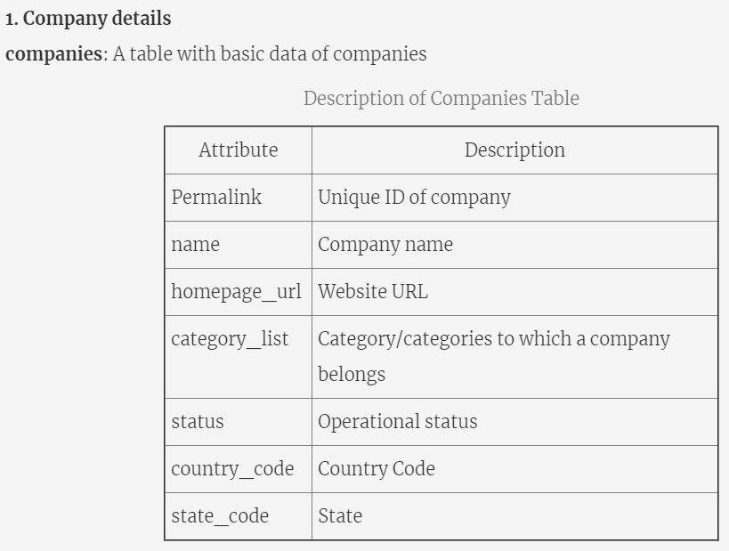
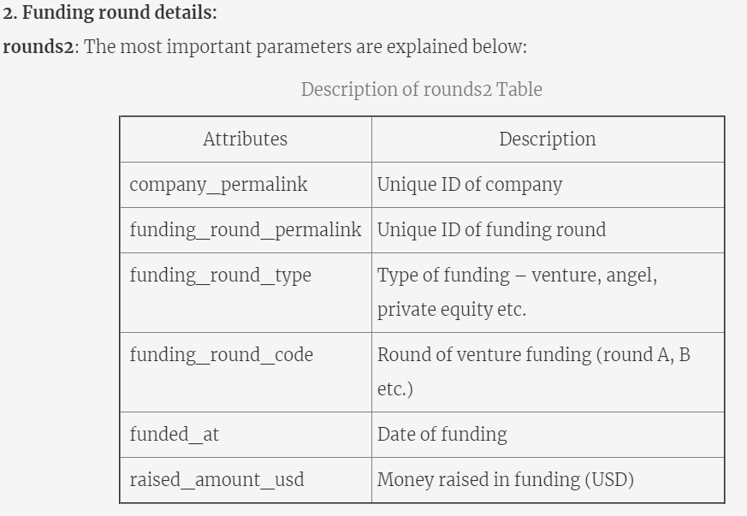
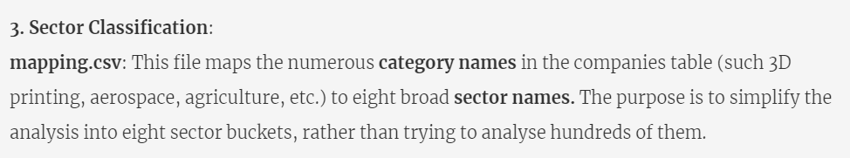
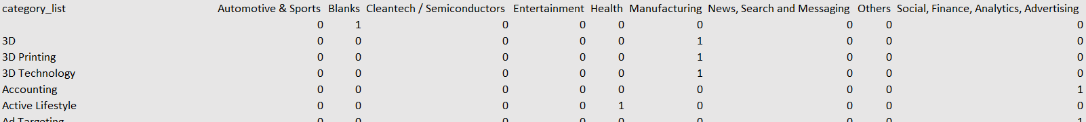
Pre-Modelling Steps: Joins
https://learn.upgrad.com/v/course/587/session/72516/segment/406262

Slide 12
Investment Case Study
The entire assignment is divided into checkpoints to help you navigate.
For each checkpoint, you are advised to fill in the tables into the spreadsheet provided in the download segment(Investment.xls).
Need to submit your insights in a ppt file. Sample PPT is provided. The structure is a suggestion; make sure not to exceed 10 slides.
Convert the PPT in PDF format for submission. You need to submit a PDF.
A single ZIP file is needed to be submitted with one Jupyter Notebook, one excel sheet and a PDF file(ppt).
Don’t forget to comment the code properly as it carries separate marks.

Slide 13

#LifeKoKaroLift
Thank You!

Slide 14
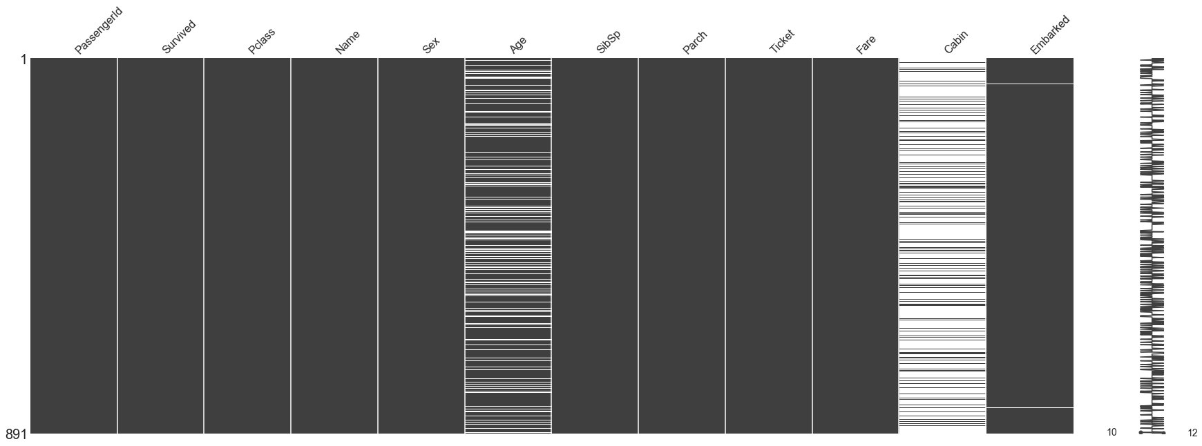
Missing Value Treatment
Data Extraction: It is possible that there are problems with extraction process. In such cases, we should double-check for correct data with data guardians. Some hashing procedures can also be used to make sure data extraction is correct. Errors at data extraction stage are typically easy to find and can be corrected easily as well.
Data collection: These errors occur at time of data collection and are harder to correct. They can be categorized in four types:

Slide 15

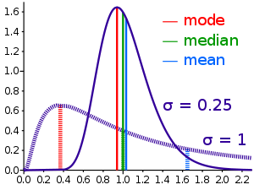
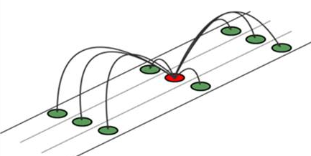
Methods to treat missing values
Data – deletion Deletion methods are used when the nature of missing data is “Missing completely at random” or we have good amount of data and the data loss would be really low ,else non-random missing values can bias the model output
Mean/ Mode/ Median Imputation Mean / Mode / Median imputation is one of the most frequently used methods. It consists of replacing the missing data for a given attribute by the mean or median (quantitative attribute) or mode (qualitative attribute) of all known values of that variable.
Prediction Model we create a predictive model to estimate values that will substitute the missing data. In this case, we divide our data set into two sets: One set with no missing values for the variable and another one with missing values. First data set become training data set of the model while second data set with missing values is test data set and variable with missing values is treated as target variable.

Slide 16

What is Exploratory Data Analysis?
“ Exploratory Data Analysis refers to the critical process of performing initial investigations on data so as to discover patterns, to spot anomalies, to test hypothesis and to check assumptions with the help of summary statistics and graphical representations.”
kinds of data source
Public data: Data collected by the government or other public agencies that are made public for the purposes of research are known as Public data.
Private data: Data generated by Banking, telecom, retail, and media are some of the key private sectors that rely heavily on data to make decisions.
Notes:
It is a good practice to understand the data first and try to gather as many insights from it. EDA is all about making sense of data in hand, before getting them dirty with it.
There are actually no shortcuts for data exploration. If you are in a state of mind, that machine learning can sail you away from every data storm, trust me, it won’t. After some point of time, you’ll realize that you are struggling at improving model’s accuracy. In such situation, only data exploration techniques will come to your rescue.
I can confidently say this, because I’ve been through such situations, a lot. To top all of that Recruiters love EDA ☺

Slide 17
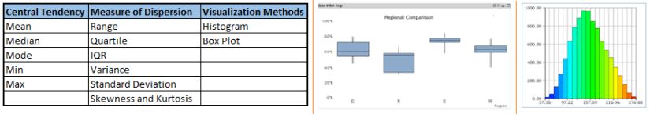
Univariate Analysis
At this stage, we explore variables one by one. Method to perform univariate analysis will depend on whether the variable type is categorical or continuous.

Slide 18
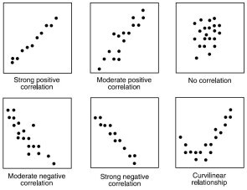
Continuous vs continuous
While doing bi-variate analysis between two continuous variables, we should look at scatter plots. It is a nifty way to find out the relationship between two variables. The pattern of scatter plot indicates the relationship between variables. The relationship can be linear or non-linear.

Slide 19
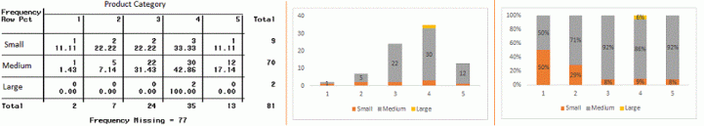
Categorical & Categorical
Two-way table: We can start analyzing the relationship by creating a two-way table of count and count%. The rows represents the category of one variable and the columns represent the categories of the other variable. We show count or count% of observations available in each combination of row and column categories.
Stacked Column Chart: This method is more of a visual form of Two-way table.

Slide 20
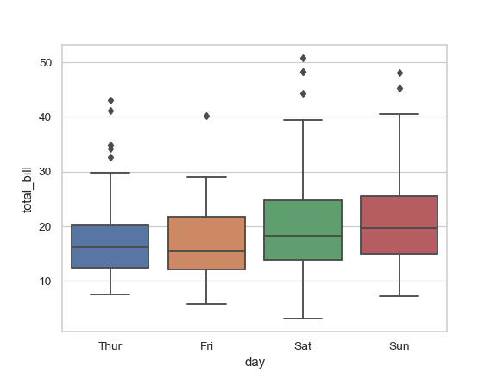
Categorical & continuous
While exploring relation between categorical and continuous variables, we can draw box plots for each level of categorical variables

Slide 21
#LifeKoKaroLift
Thank You!

